Slide 1
5.6 Terminating processes with the exit system call

Slide 2
Process Termination
There are eight ways for a process to terminate.
Normal termination occurs in five ways:
Return from main
Calling exit
Calling _exit or _Exit
Return of the last thread from its start routine
Calling pthread _exit from the last thread
Abnormal termination occurs in three ways:
Calling abort
Receipt of a signal
Response of the last thread to a cancellation request
Notes:
프로세스 종료는 크게 Normal 과 Abnormal termination으로 나뉜다. normal termination은 최종적으로 _exit()함수를 호출한다. Abnormal termination은 _exit()에 의해서 종료되지 않는 경우를 말한다. 주로 시그널과 관련된 종료로 볼 수 있다.

Slide 3
The exit(3) system call
#include <stdlib.h>
void exit(int status);
void _Exit(int status);
#include <unistd.h>
void _exit(int status);
Argument to exit is called process’ exit status
low order eight bits of which are available to the parent process( wait system call)
By convention a process returns
zero on normal terminal
non-zero if something has gone wrong
_exit and _Exit, which return to the kernel immediately.
exit performs certain cleanup processing
clean shutdown of the standard I/O library (fclose)
exit(0) is the same as return(0) from the main()
start up code
exit(main(…));
int main()
{
…
}

Slide 4
The atexit(3) system call
With ISO C, a process can register up to 32 functions that are automatically called by exit.
These are called exit handlers and are registered by calling the atexit function.
The exit function calls these functions in reverse order of their registration
Maximum number of exit handlers supported by a given platform
sysconf(_SC_ATEXIT_MAX);
#include <stdlib.h>
int atexit(void (*func)(void));
Returns: 0 if OK, nonzero on error

Slide 5
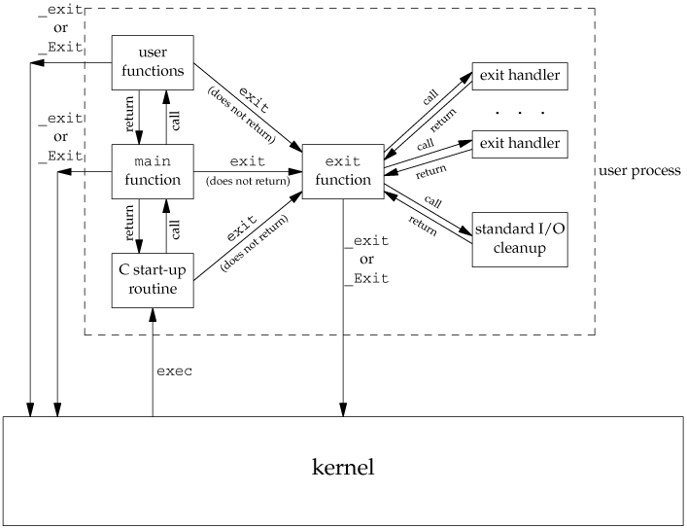
$ ./a.out $ echo $? // printing return-value of a.out
start up code
exit(main(…));
main()
{
…
}
exit first calls the exit handlers and then closes (via fclose) all open streams

Slide 6
example
void func1() { printf("print func1\n"); }
void func2() { printf("print func2\n"); }
void func3() { printf("print func3\n"); }
void func4() { printf("print func4\n"); }
int main(int argc, char** argv){
pid_t pid;
atexit(func1); atexit(func2);
atexit(func3); atexit(func4);
pid=fork();
if(pid==0){
printf("CHILD PROCESS : CALLED\n");
printf("CHILD PROCESS : EXIT CALL\n");
exit(0);
}
if(pid < 0){
perror("PARENT ERROR");
exit(1);
}
wait(NULL);
printf("PARENT PROCESS : EXIT CALL\n");
exit(0);
}
[root@localhost unix]# ./a.out
CHILD PROCESS : CALLED CHILD PROCESS : EXIT CALL print func4 print func3 print func2 print func1
PARENT PROCESS : EXIT CALL print func4 print func3 print func2 print func1

Slide 7
5.7 Synchronizing process

Slide 8
Synchronizing with children
When a process terminates(either normally or abnormally)
The kernel closes all the open descriptors for the process, releases the memory that it was using.
And the kernel keeps only proc entry for terminating process. (pid, termination status-exit(status), cpu time)
This information is remained until the parent process of the terminating process confirms it.
The parent of terminating process confirms this information through wait() system call.
After wait(), proc entry of the terminating process is released from proc table.

Slide 9
The wait(2) system call (1/2)
#include <sys/wait.h>
pid_t wait(int *statloc);
Return: child process ID if OK, 0 (see later), or -1 on error
wait temporarily suspends the execution of a process while a child process is running.
Once the child has finished, the waiting parent is restart.
If more than one child is running then wait returns as soon as any one of the parent’s offspring exit.
if wait returns (pid_t)-1, it can mean that no child exists
errno = ECHILD
Parent process can sit in a loop waiting for each of its offspring.
Notes:
wait()호출 시점에서 자식프로세스가 실행 중이면 호출 프로세스는 blocking된다. 이때, 자식프로세스가 종료되면 blocking되었던 parent프로세스는 재개된다.

Slide 10
The wait(2) system call (2/2)
int stat;
for(int i=0; i<3; i++){
if(fork()==0) {
sleep(rand()%100);
exit(i);
}
}
wait(&stat);
wait(&stat);
wait(&stat);
p
wait(&stat)
c0
c1
c2
exit(0)
exit(1)
exit(2)
while(wait(NULL)!=-1);

Slide 11
example p.104(140)
int status;
pid_cpid;
cpid = fork(); /* create new process */
if(cpid ==0){
/* child */
/* do something ... */
} else {
/* parent, so wait for child */ cpid = wait(&status);
printf(“The child %d is dead\n”, cpid);
}
------------------------------------------------------------------
pid_t pid;
int status;
pid = wait(NULL) /* ignore status information */
pid = wait(&status); /* status will contain status information */
Normally status information will be the exit-status of the child passed through exit

Slide 12
example p.105(141)
main(){ /* status -- 자식의 퇴장(exit) 상태를 어떻게 알아내는지 보여준다 */
pid_t pid;
int status, exit_status;
if((pid=fork()) < 0) fatal("fork failed");
if(pid==0){ /*자식*/
/* 이제 수행을 4초동안 중단시키기 위해 라이브러리 루틴 sleep을 호출 한다 */
sleep(4);
exit(5); /* 0이 아닌값을 가지고 퇴장 */
}
/* 여기까지 수행이 진전된 바 이것은 부모임. 자식을 기다린다. */
if((pid=wait(&status)) == -1){
perror("wait failed");
exit(2);
}
/* 자식이 어떻게 죽었는지 알기 위해 테스트한다 */
if (WIFEXITED(status)){
exit_status = WEXITSTATUS(status);
printf("Exit status from %d was %d\n", pid,exit_status);
}
exit(0);
}

Slide 13
The waitpid(2) system call(1/2)
#include <sys/wait.h>
pid_t waitpid(pid_t pid, int *statloc, int options);
Return: child process ID if OK, 0 (see later), or -1 on error
As we mentioned, if we have more than one child, wait returns on termination of any of the children.
Argument
pid
pid ==-1 | Waits for any child process. In this respect, waitpid is equivalent to wait
pid > 0 | Waits for the child whose process ID equals pid.
pid == 0 | Waits for any child whose process group ID equals that of the calling process.
pid < 0 | Waits for any child whose process group ID equals the absolute value of pid.

Slide 14
The waitpid(2) system call(2/2)
option
Constant | Description
WCONTINUED | If the implementation supports job control, the status of any child specified by pid that has been continued after being stopped, but whose status has not yet been reported, is returned (XSI extension to POSIX.1).
WNOHANG | The waitpid function will not block if a child specified by pid is not immediately available. In this case, the return value is 0.
WUNTRACED | If the implementation supports job control, the status of any child specified by pid that has stopped, and whose status has not been reported since it has stopped, is returned. The WIFSTOPPED macro determines whether the return value corresponds to a stopped child process.
This argument is either 0 or is constructed from the bitwise OR of constants.
waitpid(chidpid, &status, WCONTINUED)
waitpid(chidpid, &status, WUNTRACED)
Notes:
wait()은 좀더 정확히 말해서 자식프로세스의 상태변화를 확인하기 위한 시스템 콜이다. process job-scheduling이 안되던 예전 시스템들은 방금 말한 내용이 적용되어 지지 않는다. 즉, 이전에 설명한 것처럼 wait()는 자식프로세스의 종료상태가 목적이다. 최근 시스템들은 대부분 process job-scheduling이 지원됨으로 wait()는 자식프로세스의 상태변화를 확인하기 위한 시스템 콜로 봐도 무방할것이다.
WCONTINUED – STOP되었던 자식프로세스가 종료되었을 때, 자식의 상태정보를 얻는다.
WNOHANG – 자식이 종료될 때까지 hang(즉, blocking)이 걸리지 않음을 의미한다.
WCONTINUED – 수행되던 자식프로세스가 STOP되었을 때 자식의 상태정보를 얻는다.

Slide 15
example p.107(144)
main(){/*status2--waitpid를 사용하여 자식의 퇴장상태를 어떻게 얻는지 본다*/
pit_t pid;
int status, exit_status;
if((pid=fork()) < 0) fatal("fork failed");
if(pid==0){ /* 자식 */
/* 이제 4초동안 중단시키기 위해 라이브러리 루틴 sleep을 호출한다 */
sleep(4);
exit(5); /* 0이 아닌 값을 가지고 퇴장한다 */
}
/* 여기까지 수행이 진전된 바 이것은 부모임. 따라서 자식이 퇴장했는지 확인한다.
퇴장하지 않았으면, 1초 동안 수면한 후 다시 검사한다. */
while(waitpid(pid, &status, WNOHANG) == 0){
printf("Still waiting... \n");
sleep(1);
}
/* 자식이 어떻게 죽었는지 알기 위해 테스트한다 */
if (WIFEXITED(status)){
exit_status = WEXITSTATUS(status);
printf("Exit status from %d was %d\n", pid,exit_status);
}
exit(0);
}

Slide 16
wait(2) & waitpid(2) Functions
Differences between these two functions
The wait function can block the caller until a child process terminates, whereas waitpid has an option that prevents it from blocking(WNOHANG).
The waitpid function doesn't wait for the child that terminates first; it has a number of options that control which process it waits for

Slide 17
Confirm the exit status (1/2)
Macro | Description
WIFEXITED(status) WEXITSTATUS(status) | evaluates to a nonzero value when the child terminates normally. If WIFEXITED evaluates to a nonzero value, then WEXITSTATUS evaluates to the low-order 8 bits returned by the child through _exit(), exit() or return from main.
WIFSIGNALED(status) WTERMSIG(status) WCOREDUMP(status) | evaluates to a nonzero value when the child terminates because of an uncaught signal. If WIFSIGNALED evaluates to a nonzero value, then WTERMSIG evaluates to the number of the signal that caused the termination.
WIFSTOPPED(status) WSTOPSIG(status) | evaluates to a nonzero value if a child is currently stopped. If WIFSTOPPED evaluates to a nonzero value, then WSTOPSIG evaluates to the number of the signal that caused the child process to stop.
WIFCONTINUED(status) | evaluates to a nonzero value if a child is currently continued.
Notes:
위 매크로들은 자식의 상태변화를 확인하기 위한 매크로들이다. WIF로 시작하는 매크로들은 어떠한 형태로 자식프로세스의 상태가 변경되었는지를 확인할 때 쓰인다. 각 WIF카테고리 아래에 있는 매크로들은 각 상태에 따른 정보들을 확인할 때 사용된다.

Slide 18
Confirm the exit status (2/2)
#include <sys/wait.h>
void pr_exit(int status)
{
if (WIFEXITED(status))
printf("normal termination, exit status = %d\n",
WEXITSTATUS(status));
else if (WIFSIGNALED(status))
printf("abnormal termination, signal number = %d%s\n",
WTERMSIG(status),
#ifdef WCOREDUMP
WCOREDUMP(status) ? " (core file generated)" : "");
#else
"");
#endif
else if (WIFSTOPPED(status))
printf("child stopped, signal number = %d\n",
WSTOPSIG(status));
}

Slide 19
5.8 Zombie and premature exits

Slide 20
Zombie Process (defunct process) (1/2)
If parent doesn’t wait()on the child that has terminated, it becomes a zombie (status “Z” seen with ps).
Zombies hang around till parent calls wait()or waitpid().
It is a process that has completed execution but still has an entry in the process table. →p.8
while(pid=fork()){
if(++count==3) break;
}
if (pid == 0){
sleep(5);
printf("I will be back %d\n", getpid());
exit(0); /* 자식은 먼저 죽는다 */
}
else if(pid > 0){
printf("Im parent %d\n", getpid());
printf("Press any key\n");
getchar(); /* 자식이 죽을 때까지 기다린다 */
}

Slide 21
Zombie Process (defunct process) (2/2)
p
c
fork()
SIGCHLD
exit(status)
zombie
wait(&status)

Slide 22
Orphan Process (1/2)
When a parent process dies, child process becomes an orphan process.
The init process (pid = 1) becomes the parent of orphan processes.
The init process periodically waits for children, so eventually orphaned zombies are removed.
while(pid=fork()){
if(++count==3) break;
}
if (pid == 0){
printf("I will be back %d\n", getpid());
sleep(500);
exit(0);
}
else if(pid > 0){
printf("Im parent %d\n", getpid());
printf("Press any key\n");
getchar(); /* 먼저 엔터를 치고 부모는 종료한다 */
}

Slide 23
Orphan Process (2/2)
init
p
c
fork()
exit()
orphan
SIGCHLD
exit(status)
zombie
wait(&status)

Slide 24
5.9 smallsh: a command processor

Slide 25
Basic logic of command processor
while(EOF not typed)
{
Get command line from user ← userin()
Assemble command args and execute ← procline()
Wait for child
}
Notes:
쉘의 처리과정은 다음과 같다.
사용자입력을 받는다.
명령을 실을 프로세스를 생성한다.(fork())
새로 생성된 자식 프로세스는 입력 받은 문자열을 exec호출에 적합한 형태로 구성한다.
exec호출을 한다.
이 4 단계를 계속적을 반복 하는 것이 쉘이다.

Slide 26
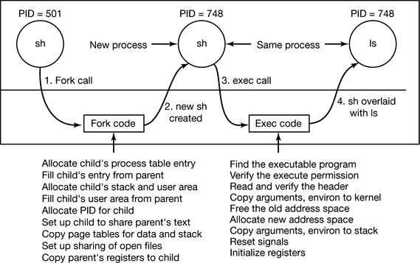
The steps in executing the ls (1/2)
Notes:
fork
- 새로 생성된 자식프로세스를 위한 proc테이블 엔트리를 할당.
- 부모프로세스의 proc테이블 엔트리를 자식프로세스 porc테이블 엔트리에 복사
- 자식 프로세스를 위한 스택과 사용자 공간을 할당.
- 자식 프로세스에게 새로운 pid번호를 할당
- 부모프로세스의 text 영역이 공유되도록 설정.
- 데이터와 스택영역을 복사
- open된 파일들이 공유될 수 있도록 설정.
- 부모 프로세스의 레지스터 값들을 자식에게 복사.
exec
- exec()에 주어진 실행파일을 검색
- 현재 프로세스가 해당 실행파일을 실행할 수 있는지 퍼미션 테스트.
- 실행파일이 실행모듈인지 쉘-스크립트인지를 구분하기 위해 파일의 header로부터 magic number를 읽음.
- exec()에 주어진 argumets 와 environ 파라미터를 커널로 복사.
- 새로운 프로그램 레이아웃으로 변경하기 위해 이전 메모리레이웃을 할당해제.
- 새로운 메모리 레이아웃 공간을 할당.
- arguments들과 environ을 커널로부터 얻어서 main함수로 넘김.
- 현재 프로세스의 signal들과 레지스터들을 초기화

Slide 27
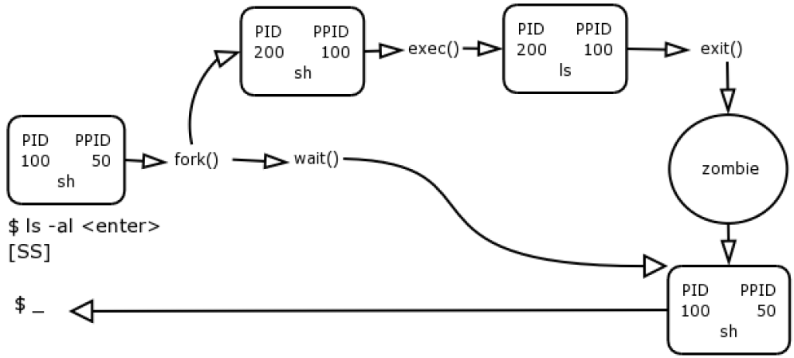
The steps in executing the ls (2/2)

Slide 28
smallsh – Header & global variables
/* smallsh.h –smallsh명령 처리기를 위한 정의들 */
#include <unistd.h>
#include <stdio.h>
#include <sys/wait.h>
#define EOL 1
#define ARG 2
#define AMPERSAND 3
#define SEMICOLON 4
#define MAXARG 512
#define MAXBUF 512
#define FOREGROUND 0
#define BACKGROUND 1
/* 프로그램 버퍼 및 작업용 포인터들 */
static char inbuf[MAXBUF], tokbuf[2*MAXBUF],
*ptr = inbuf, *tok=tokbuf;
Notes:
foreground : 쉘이 명령실행 시 처리 될 때까지 기다린다.
background : 쉘은 명령을 실행하고 곧바로 다른 명령을 처리할 수 있도록 대기한다.

Slide 29
smallsh – userin()
int userin(char *p) {
int c, count;
ptr = inbuf; tok = tokbuf;
printf("%s", p); /* 명령 프롬프트 출력 */
count = 0; /* 사용자 입력 문자개수를 저장하기 위한 카운트 변수 */
while(1){
if( (c=getchar()) == EOF) /* EOF == ^D */
return EOF;
if( count < MAXBUF )
inbuf[count++] = c;
if( (c=='\n') && (count < MAXBUF) ){
inbuf[count] = '\0';
return count;
}
if( c=='\n' ){
printf("smallsh: inputline too long\n");
count = 0;
printf("%s",p);
}
}
}
char *prompt = "Command> ";
inpbuf
count=7
 | l | s |  | - | l | \n | \0
ptr
MAXBUF
tokbuf
tok
Notes:
userin()은 새로운 명령 입력에 따라 procline()처리시 inpbuf와 tokbuf을 조작하기 위한 ptr과 tok를 초기화한다.

Slide 30
smallsh – procline()
int procline(){
char* arg[MAXARG+1]; /* runcommand 를 위한 포인터 배열 */
int toktype =0; /* 명령내 토큰의 유형 */
int narg = 0; /* 지금까지 인수 수 */
int type; /* foreground 또는 background */
for(;;) {
switch(toktype = gettok(&arg[narg])) {
case ARG: if(narg < MAXARG) narg++; break;
case EOL:
case SEMICOLON:
case AMPERSAND:
if ( toktype == AMPERSAND ) type = BACKGROUND;
else type = FOREGROUND;
if ( narg != 0 ){
arg[narg] = NULL;
runcommand(arg, type);
}
if( toktype == EOL) return;
narg = 0;
break;
}
}
}
inpbuf
count=7
 | l | s |  | - | l | \n | \0
ptr
MAXBUF
tokbuf
l | s | \0 | - | l | \0
MAXARG+|
tok
NULL

Slide 31
smallsh – gettok()
/* 토큰을 가져와서 tokbuf에 넣는다. */
int gettok (char **outptr){
int type;
*outptr = tok; /* outptr 문자열을 tok로 지정한다. */
while ( *ptr == ‘ ' || *ptr == '\t') /*토큰을 포함하고 있는 버퍼로부터 여백 제거*/
ptr++;
*tok++ = *ptr; /* 토큰 포인터를 버퍼내의 첫 토큰으로 지정한다. */
switch (*ptr++){/*버퍼내의 토큰에 따라 유형 변수를 지정한다. */
case '\n': type = EOL; break;
case '&': type = AMPERSAND; break;
case ';': type = SEMICOLON; break;
default: type = ARG;
/* 유효한 보통문자들을 계속 읽는다. */
while (inarg (*ptr))
*tok++ = *ptr++;
}
*tok++ = '\0';
return type;
}
inpbuf
 | l | s |  | - | l | \n
ptr
tokbuf
l
{' ', '\t', '&', ';', '\n', '\0'};
tok
l | s | \0

Slide 32
smallsh – runcommand()
int runcommand(char **cline, int where){/*wait를 선택사항으로 명령을 수행*/
pid_t pid;
int status;
switch (pid = fork()) {
case -1:
perror ("smallsh");
return (-1);
case 0:
execvp (*cline, cline);
perror (*cline);
exit (1);
}
/* 부모의 코드-만일 백그라운드 프로세스이면 프로세스 식별자를 프린트하고 퇴장한다 */
if (where == BACKGROUND){
printf ("[Process id %d]\n", pid);
return (0);
}
/* 프로세스 pid가 퇴장할 때까지 기다린다. */
if (waitpid (pid, &status, 0) == -1)
return (-1);
else
return (status);
}

Slide 33
smallsh – inarg(), main()
static char special [] = {' ', '\t', '&', ';', '\n', '\0'};
int inarg (char c)
{
char *wrk;
for (wrk = special; *wrk; wrk++){
if (c == *wrk)
return (0);
}
return (1);
}
#include "smallsh.h"
char *prompt = "Command> "; /* 프롬프트 */
main()
{
while(userin(prompt) != EOF)
procline();
}

Slide 34
5.10 Process Attributes

Slide 35
The process-id
#include <unistd.h>
pid_t getpid(void);
Returns: process ID of calling process
pid_t getppid(void);
Returns: parent process ID of calling process
uid_t getuid(void);
Returns: real user ID of calling process
uid_t geteuid(void);
Returns: effective user ID of calling process
gid_t getgid(void);
Returns: real group ID of calling process
gid_t getegid(void);
Returns: effective group ID of calling process

Slide 36
Process ID 0 & 1
Scheduler process (swapper) : Process ID 0
No program on disk corresponds to this process,
which is part of the kernel and is known as a system process.
Init process : Process ID 1
invoked by the kernel at the end of the bootstrap procedure.
The program file for this process was /etc/init in older versions of the UNIX System and is /sbin/init in newer versions.
This process is responsible for bringing up a UNIX system
The init process never dies.
It is a normal user process, not a system process within the kernel, like the swapper, run with superuser privileges.
Notes:
process id 0는 스케쥴러 프로세스이며, 종종 swapper로서 알려져 있다. 이 프로세스에 대응되는 프로그램은 디스크 상에 존재하지 않는다. 시스템 프로세스로 커널의 일부분이다. 유닉스 시스템을 구동한다.

Slide 37
example p.115(156) (1/2)
static int num = 0;
static char namebuf[20];
static char prefix[] = "/tmp/tmp";
char *gentemp(void){
int length;
pid_t pid;
pid = getpid(); /* 프로세스 식별번호를 얻는다. */
/* 표준 문자열처리 루틴들 <string.h> */
strcpy (namebuf, prefix);
length = strlen(namebuf);
/* 화일 이름에 프로세스 식별번호(pid)를 추가한다. */
itoa (pid, &namebuf[length]); /* filename : /tmp/tmp#pid */
strcat (namebuf, ".");
length = strlen (namebuf);
do{
itoa (num++, &namebuf[length]); /* 접미 번호를 추가한다. */
} while (access(namebuf, F_OK) != -1); /* test for existence of file */
return (namebuf); /* filename : /tmp/tmp#pid.#num */
}

Slide 38
example p.115(156) (2/2)
/* itoa --정수를 문자열로 변환한다.*/
int itoa(int i, char *string)
{
int power, j;
j = i;
for (power = 1; j >= 10; j /= 10) /* i = 1234, power=1000 */
power *= 10;
for ( ; power > 0; power /=10)
{
*string++ = '0' + i/power;
i %=power;
}
*string = '\0';
}
atoi ??

Slide 39
Process groups and process group-ids(1/2)
A process group is a collection of one or more processes, usually associated with the same job
processes are connected by pipes
Each process group has a unique process group ID.
Process group IDs are similar to process IDs:
positive integers
pid_t data type.
Each process group can have a process group leader.
if (pid == pgid) process group leader
#include <unistd.h>
pid_t getpgrp(void);
Returns: process group ID of calling process
pid_t getpgid(pid_t pid); /* getpgid(0) == getpgrp() */
Returns: process group ID if OK, -1 on error
Notes:
보통 프로세스의 pgid는 부모로부터 상속 받는다.

Slide 40
Process groups and process group-ids(2/2)
[root@localhost root]# ps -o "pid ppid pgrp session tpgid comm" | cat
PID PPID PGRP SESS TPGID COMMAND
10617 10606 10617 10617 10692 bash
10692 10617 10692 10617 10692 ps
10693 10617 10692 10617 10692 cat
[root@localhost root]#

Slide 41
Changing process group(1/2)
#include <unistd.h>
int setpgid(pid_t pid, pid_t pgid);
Returns: 0 if OK, -1 on error
This function sets the process group ID to pgid in the process whose process ID equals pid.
A process can set the process group ID of only itself or any of its children.
Furthermore, it can't change the process group ID of one of its children after that child has called one of the exec functions.
pid==pgid | the process specified by pid becomes a process group leader
pid==0 | the process ID of the caller is used
pgid==0 | the process ID specified by pid is used as the process group ID

Slide 42
Sessions and session-ids(1/3)
A session is a collection of one or more process groups.
The process groups within a session can be divided into a single foreground process group and one or more background process groups.
Notes:
한 프로세스 그룹의 프로세스들은 pipe로 연결되어 있음

Slide 43
Sessions and session-ids(2/3)
#include <unistd.h>
pid_t getsid(pid_t pid);
Returns: session leader's process group ID if OK, -1 on error
If pid is 0, getsid returns the process group ID of the calling process's session leader.
Daemon process
is simply a process which does not have a controlling terminal
an example is cron

Slide 44
Sessions and session-ids(3/3)
#include <unistd.h>
pid_t setsid(void);
Returns: process group ID if OK, -1 on error
If the calling process is not a process group leader, this function creates a new session.
Three things happen.
The process becomes the session leader of this new session. (A session leader is the process that creates a session.)
The process becomes the process group leader of a new process group.
The process has no controlling terminal. If the process had a controlling terminal before calling setsid, that association is broken.

Slide 45
The current working & root directory(1/2)
The current working directory
Current working directory is inherited across the fork or exec that started the process.
A per-process attribute
If a child process changes position by calling chdir, the current working directory in the parent process is unchanged.
The current root directory
Each process is also associated with a root directory used in absolute pathname searches
Where the start of the file system hierarchy is.

Slide 46
The current working & root directory(2/2)
#include <unistd.h>
int chroot(const char *path);
Return: 0 if OK, -1 on error
If chroot succeeds, path will become the starting point for those file searches that begin with a ‘/’
For calling process only, the system as a while is not affected
int main() {
int pid;
if (chroot("/home/mydir") != 0){ /* ‘/’ == ‘/home/mydir’ */
perror("chroot");
exit(0);
}
if (execl("/bin/bash","bash", NULL) == -1) /* ‘/home/mydir/bin/bash’ */ perror("error");
}

Slide 47
Changing User IDs and Group IDs(1/2)
In the UNIX System, privileges, such as being able to change the system's notion of the current date, and access control, such as being able to read or write a particular file, are based on user and group IDs.
We can set the real user ID and effective user ID with the setuid function.
Similarly, we can set the real group ID and the effective group ID with the setgid function.
#include <unistd.h>
int setuid(uid_t uid);
int setgid(gid_t gid);
Both return: 0 if OK, -1 on error

Slide 48
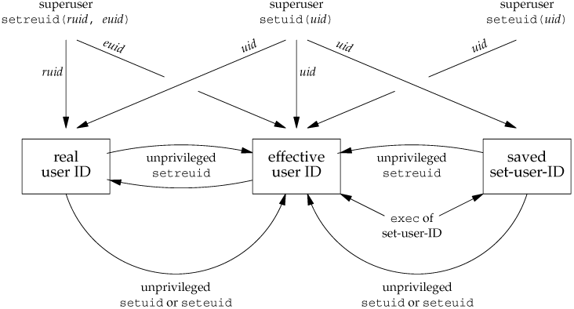
Changing User IDs and Group IDs(2/2)

Slide 49
File size limits: ulmit
#include <ulimit.h>
long ulimit(int cmd, [long newlimit]);
Return: the value of the requested limit if OK, -1 on error
There is a per process limit on the size of a file that can be created with the write system call
To obtain the current file size limit
the parameter cmd set to UL_GETFSIZE
To change the file size limit
the parameter cmd set to UL_SETFSIZE
with newlimit
Only superuser can actually increase a file size limit in this way.
Process that effective user-ids of other user are, however, allowed to decrease their limit.

Slide 50
Process priorities: nice
The system decides the proportion of cpu time a particular process is allocated partly on the basis of an integer nice value.
Nice value range
0 ~ system-dependent maximum
the higher the number, the lower the process’ priority.
Superuser processes can increase their priority by using a negative value as the nice call parameter

